Slide 1

COMPUTER NETWORKS
Sivaraman Eswaran Ph.D.
Department of Computer Science and Engineering

Slide 2

COMPUTER NETWORKS
Application Layer
Sivaraman Eswaran Ph.D.
Department of Computer Science and Engineering

Slide 3
COMPUTER NETWORKS
Unit – 2 Application Layer
2.1 Principles of Network Applications
2.2 Web, HTTP and HTTPS
2.3 The Domain Name System
2.4 P2P Applications
2.5 Socket Programming with TCP & UDP
2.6 Other Application Layer Protocols

Slide 4

COMPUTER NETWORKS
DNS name resolution: iterated query
Example: host at engineering.nyu.edu wants IP address for gaia.cs.umass.edu
root DNS server
2
3
TLD DNS server
Iterated query:
contacted server replies with name of server to contact
“I don’t know this name, but ask this server”
1
4
8
5
requesting host at
engineering.nyu.edu
local DNS server
dns.nyu.edu
gaia.cs.umass.edu
7
6
authoritative DNS server
dns.cs.umass.edu

Slide 5
COMPUTER NETWORKS
DNS name resolution: recursive query
Example: host at engineering.nyu.edu wants IP address for gaia.cs.umass.edu
root DNS server
2
3
7
6
Recursive query:
puts burden of name resolution on contacted name server
heavy load at upper levels of hierarchy?
1
TLD DNS server
8
requesting host at
engineering.nyu.edu
local DNS server
dns.nyu.edu
5
4
gaia.cs.umass.edu
authoritative DNS server
dns.cs.umass.edu

Slide 6
COMPUTER NETWORKS
Caching and Updating DNS Records
Suppose that a host apricot.nyu.edu queries dns.nyu.edu for the IP address for the hostname cnn.com. After an hour later, another NYU host, say, kiwi.nyu.edu, also queries dns.nyu.edu.
once (any) name server learns mapping, it caches mapping
cache entries timeout (disappear) after some time (TTL)
TLD servers typically cached in local name servers
thus root name servers not often visited
cached entries may be out-of-date (best-effort name-to-address translation!)
if name host changes IP address, may not be known Internet-wide until all TTLs expire!
update/notify mechanisms proposed IETF standard
RFC 2136

Slide 7
COMPUTER NETWORKS
DNS Records
DNS: distributed database storing resource records (RR)
RR format: (name, value, type, ttl)
type=A
name is hostname
value is IP address
type=CNAME
name is alias name for some “canonical” (the real) name
www.ibm.com is really servereast.backup2.ibm.com
value is canonical name
relayl.bar.foo.com, 145.37.93.126, A
ibm.com, servereast.backup2.ibm.com, CNAME
type=NS
name is domain (e.g., foo.com)
value is hostname of authoritative name server for this domain
type=MX
value is canonical name of a mailserver associated with alias hostname name
foo.com, dns.foo.com, NS
example.com, mail.example.com, MX

Slide 8
COMPUTER NETWORKS
DNS Protocol Messages
DNS query and reply messages, both have same format:
2 bytes
2 bytes
message header:
identification: 16 bit # for query, reply to query uses same #
flags:
query or reply (1-bit)
recursion desired
recursion available
reply is authoritative
identification
flags
# questions
# answer RRs
12 bytes
# authority RRs
# additional RRs
questions (variable # of questions)
Name, type fields for
a query
answers (variable # of RRs)
RRs in response to query
authority (variable # of RRs)
Records for
authoritative servers
additional info (variable # of RRs)
Additional “helpful”
info that may be used

Slide 9
COMPUTER NETWORKS
DNS Protocol Messages
DNS query and reply messages, both have same format:
2 bytes
2 bytes
identification
flags
# questions
# answer RRs
# authority RRs
# additional RRs
name, type fields for a query
questions (variable # of questions)
Type (for example, A, NS, CNAME, and MX), the Value, and the TTL.
RRs in response to query
answers (variable # of RRs)
records for authoritative servers
authority (variable # of RRs)
additional “ helpful” info that may be used
additional info (variable # of RRs)

Slide 10
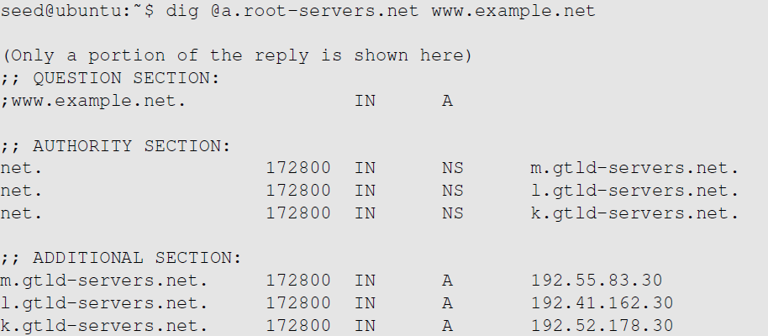
COMPUTER NETWORKS
Emulating Local DNS Server (Step 1: Ask Root)
Directly send the query to this server.
No answer (the root does not know the answer)
Go ask them!

Slide 11
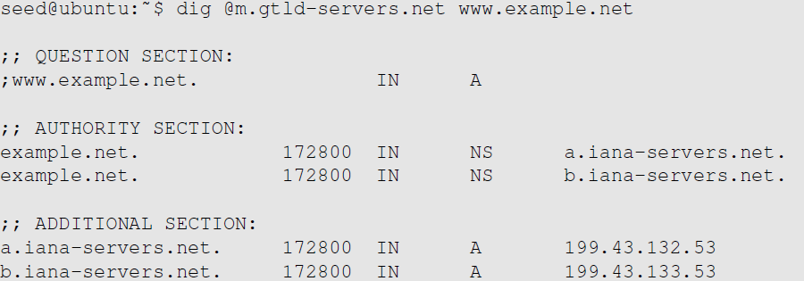
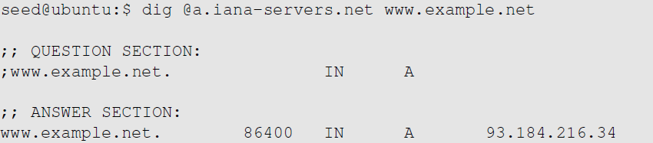

COMPUTER NETWORKS
Steps 2-3: Ask .net & example.net servers
Ask a .net nameservers.
Go ask them!
Ask an example.net nameservers.
Finally got the answer

Slide 12
COMPUTER NETWORKS
Summary

Slide 13
COMPUTER NETWORKS
Inserting records into DNS
Example: new startup “Network Utopia”
register name networkuptopia.com at DNS registrar (e.g., Network Solutions)
provide names, IP addresses of authoritative name server (primary and secondary)
registrar inserts NS, A RRs into .com TLD server:
(networkutopia.com, dns1.networkutopia.com, NS)
(dns1.networkutopia.com, 212.212.212.1, A)
create authoritative server locally with IP address 212.212.212.1
type A record for www.networkuptopia.com
type MX record for networkutopia.com

Slide 14
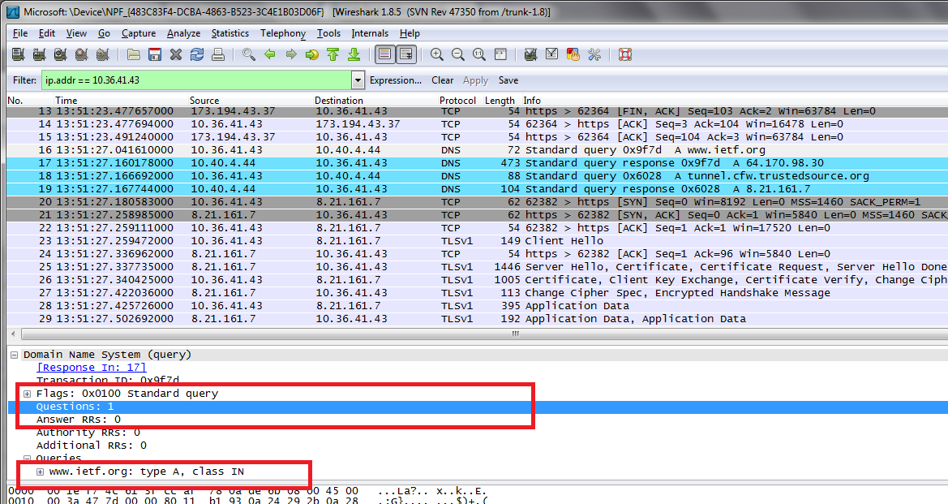
COMPUTER NETWORKS
DNS Request - Wireshark Packet Capture

Slide 15
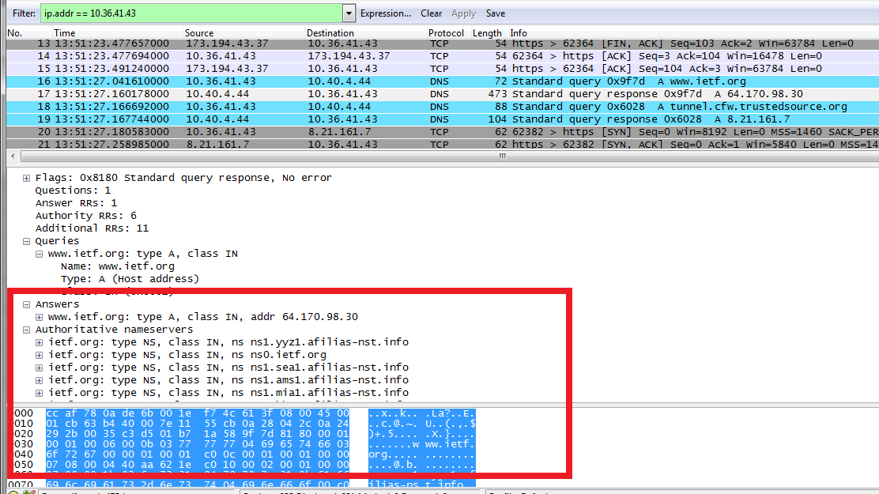
COMPUTER NETWORKS
DNS Response - Wireshark Packet Capture

Slide 16


COMPUTER NETWORKS
Suggested Readings
DNS (Domain Name System) – Explained – https://youtu.be/JkEYOt08-rU
How a DNS Server (Domain Name System) works – https://youtu.be/rdVPflECed8
Wireshark Lab: DNS v7.0 – http://www-net.cs.umass.edu/wireshark-labs/Wireshark_DNS_v7.0.pdf

Slide 17
THANK YOU
Sivaraman Eswaran Ph.D.
Department of Computer Science and Engineering
sivaramane@pes.edu
+91 80 6666 3333 Extn 834

